Slide 1
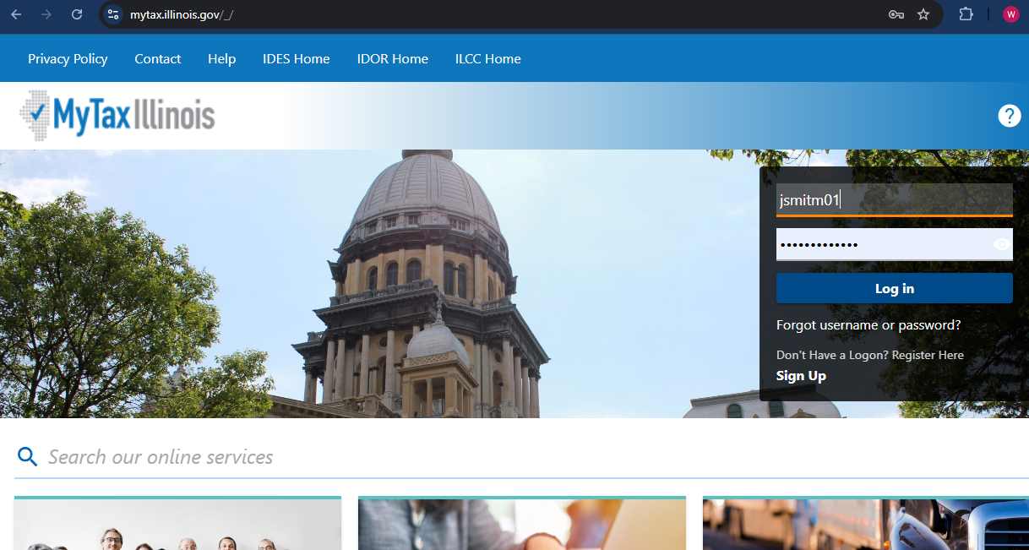
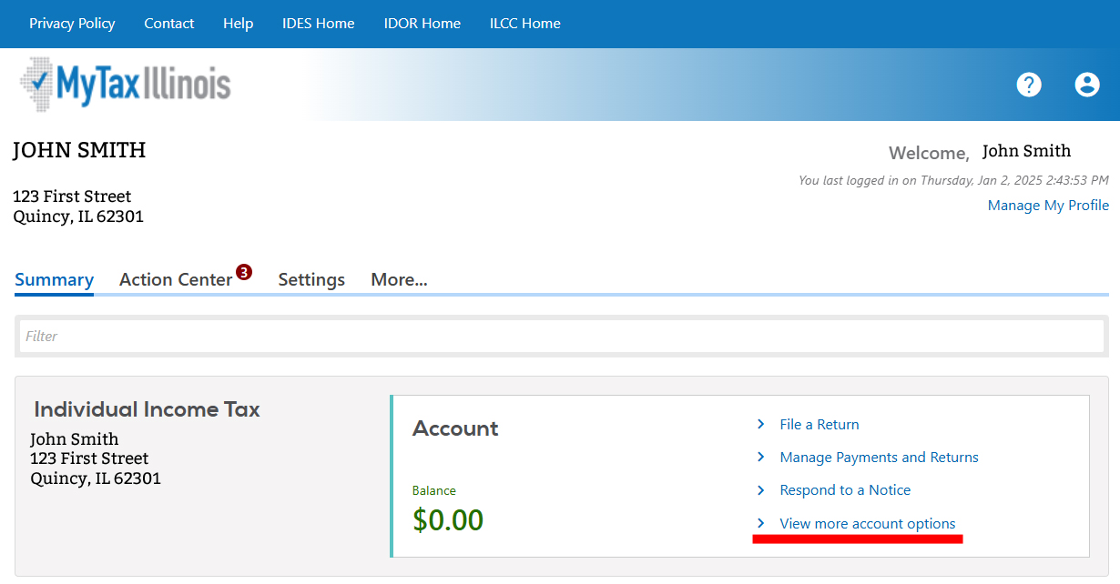
ILLINOIS GIVES: STEP-BY-STEP DONOR INSTRUCTIONS
Step 1: Once you have established your MyTax Illinois login, go to mytax.Illinois.gov and enter your credentials in the top-righthand login box.
Step 2: Once logged in, click “View more account options” in the “Individual Income Tax” section of the Summary page.

Slide 2
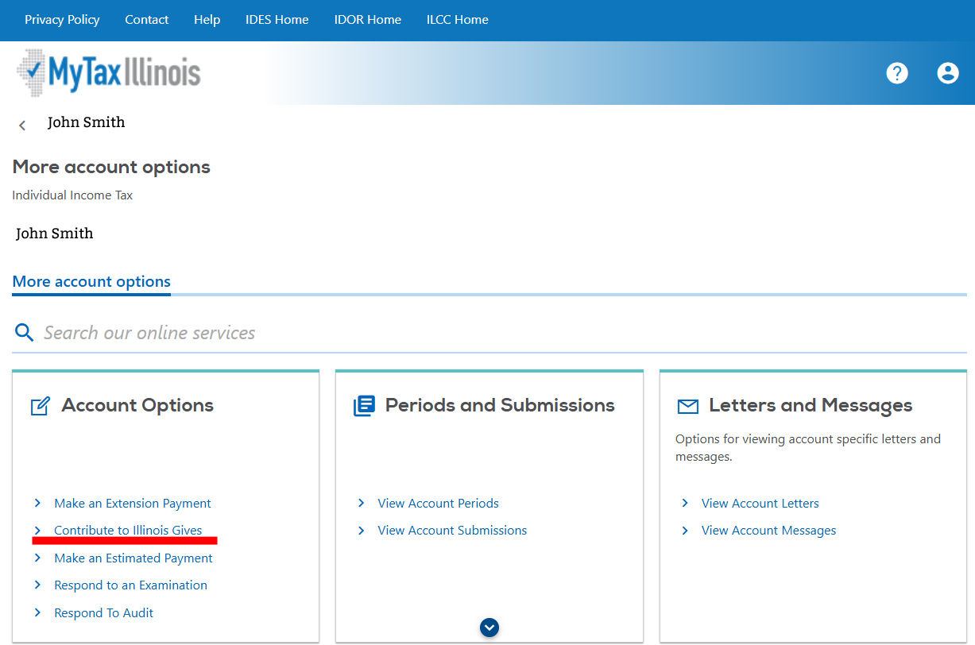
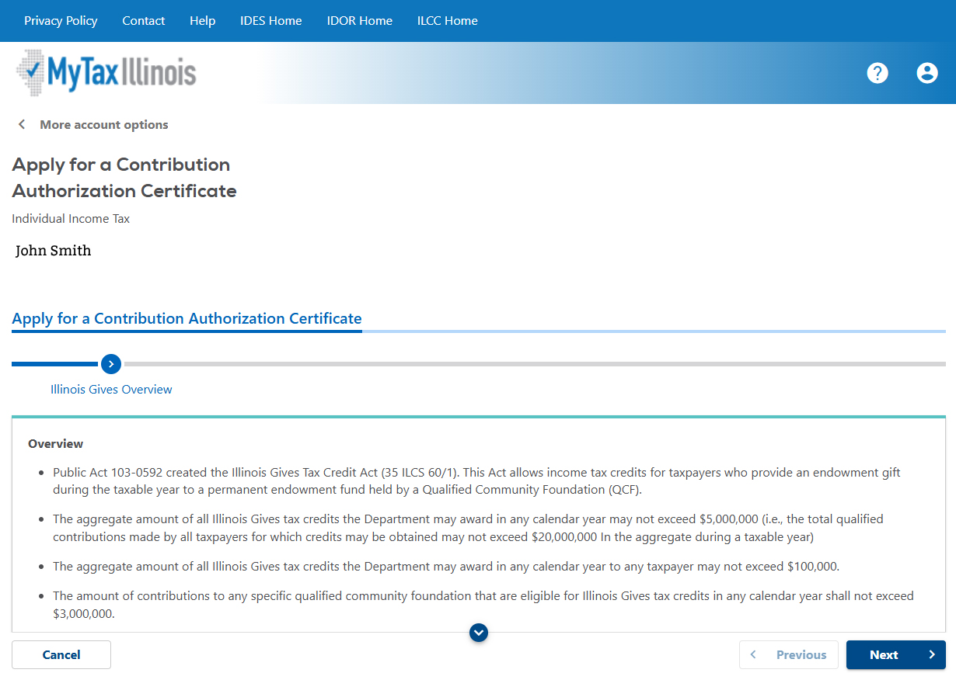
Step 3: Click “Contribute to Illinois Gives” under the “Account Options” box.
Step 4: Click “Next”

Slide 3
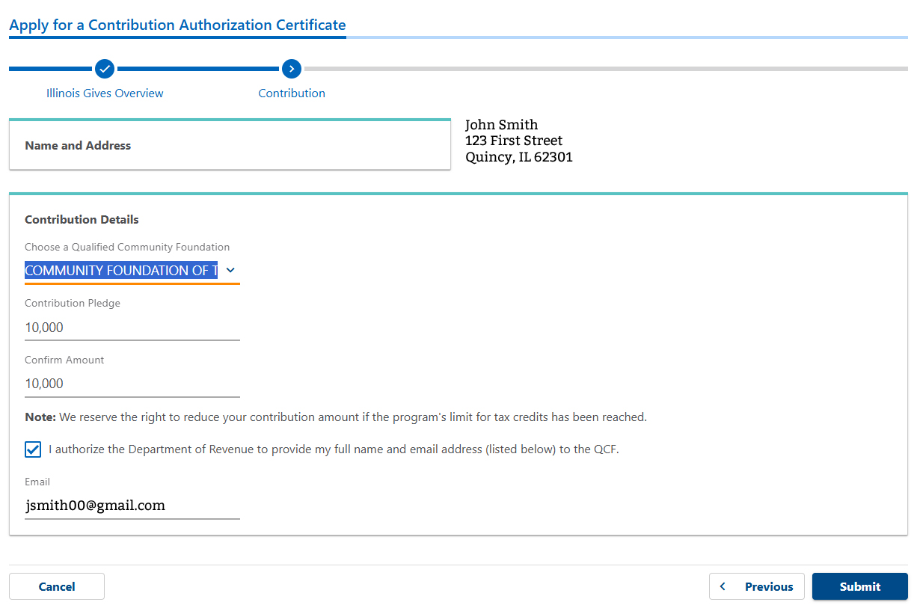
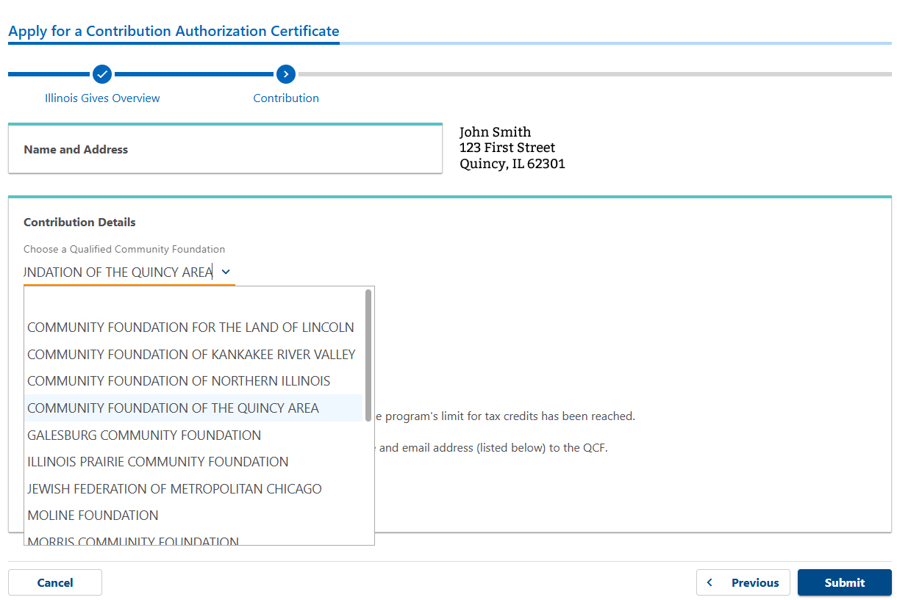
Step 5: Now, you will be at a form to submit gift details. Enter gift information and from the drop-down menu, select “COMMUNITY FOUNDATION OF THE QUINCY AREA.” Once gift information is entered, click “Submit.”

Slide 4
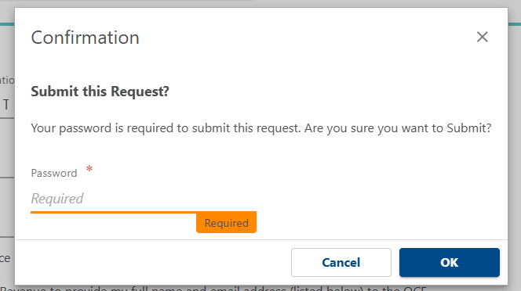
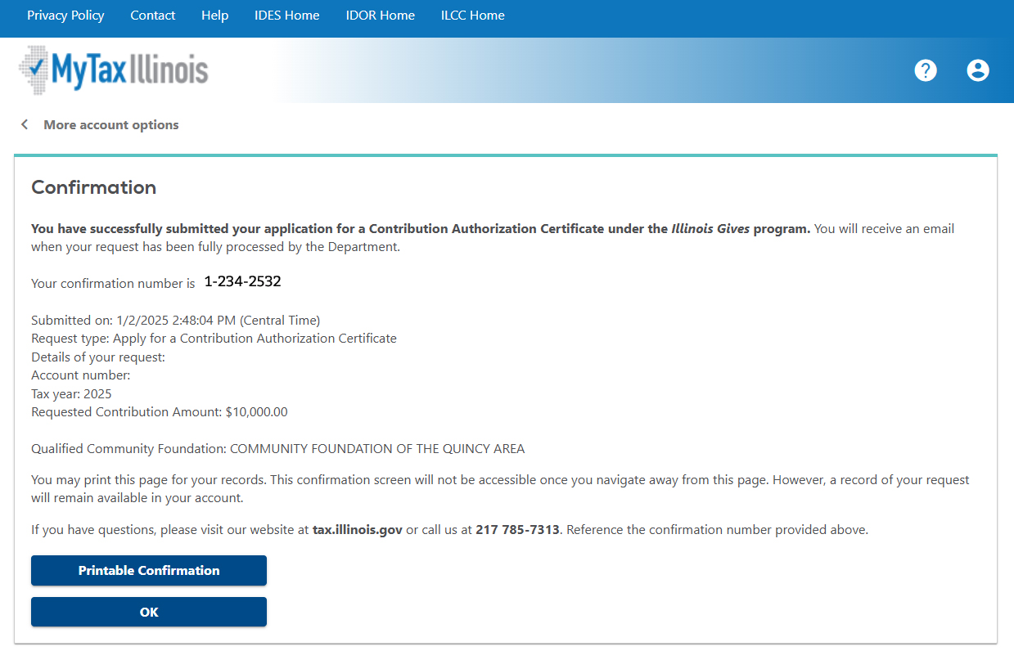
Step 6: A confirmation box will appear after you submit the gift information. You now must re-enter your password and then click “OK.”
Step 7: After successfully submitting the form, you will be presented a confirmation page. Print for your records. Be sure to notify the Community Foundation of the gift and to which fund you would like it directed to.

Slide 5
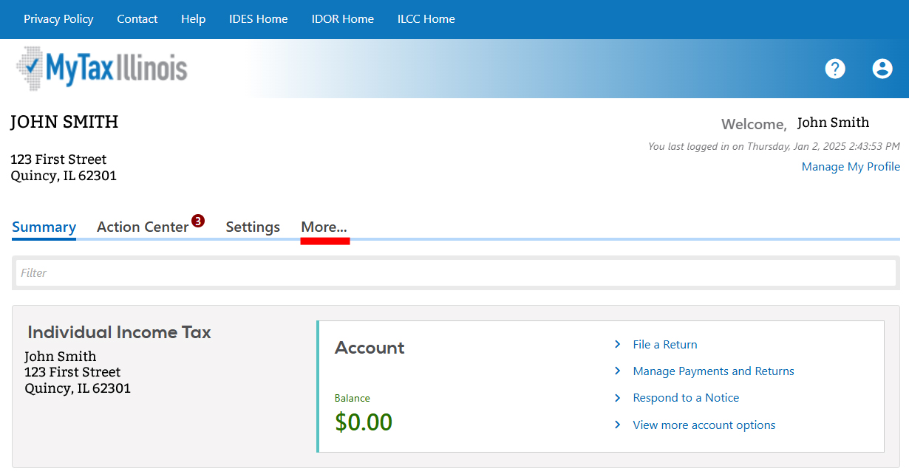
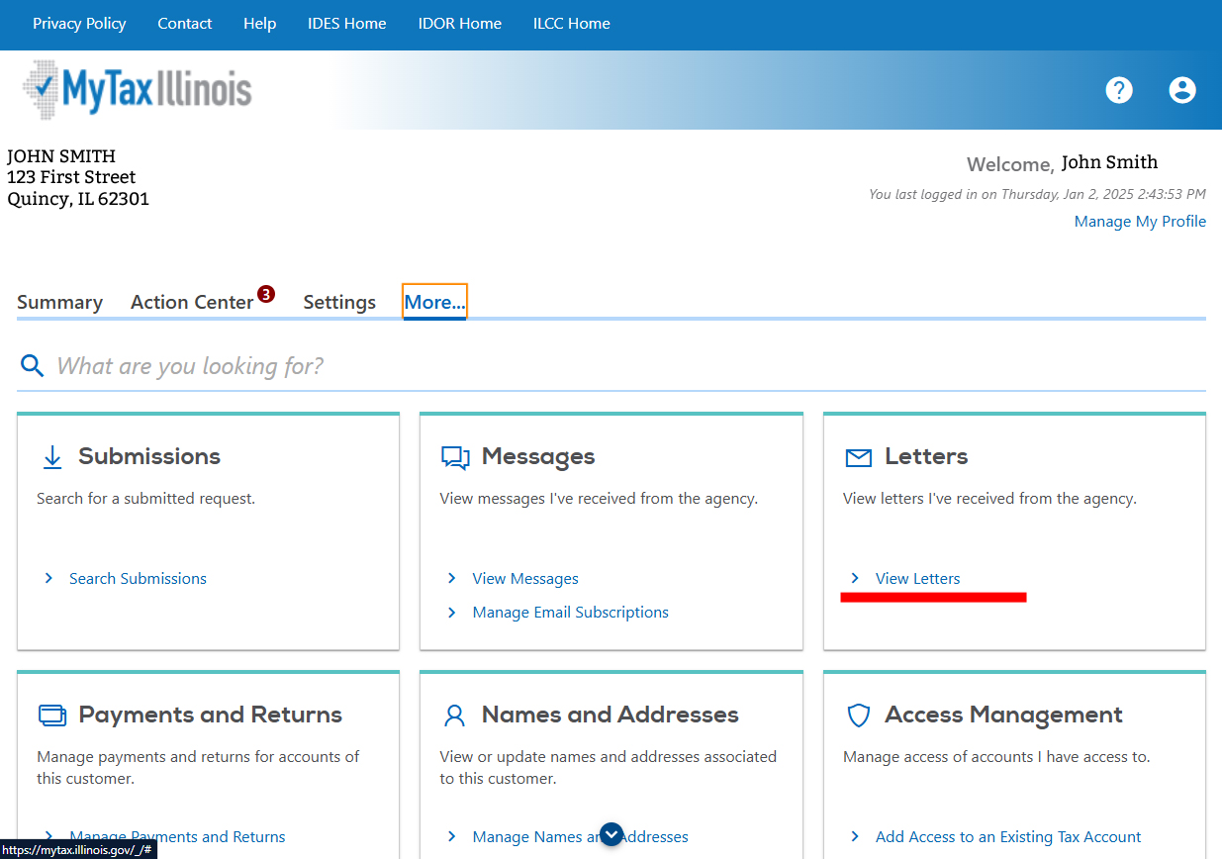
Step 8: Once you have submitted the request, you can check the status of the authorization within your MyTax account. From your summary page, click “More…”
Step 9: In the “Letters” box, select “View Letters”

Slide 6
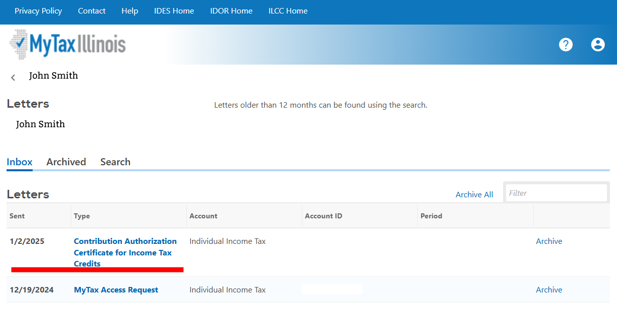
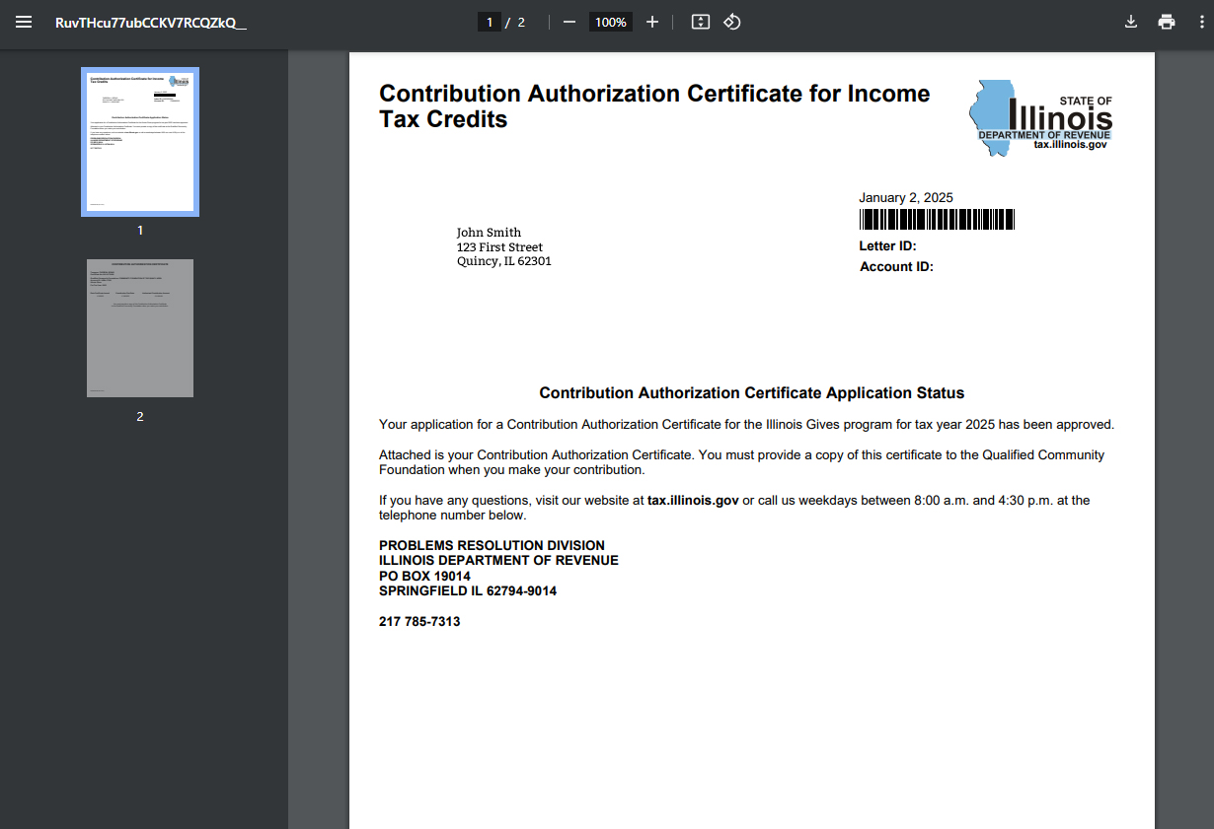
Step 10: Once the gift has been authorized by the Illinois Department of Revenue, you will see a “Contribution Authorization Certificate for Income Tax Credits.” This confirms that you may now move forward with making the gift as described in your Illinois Gives application.
Once the gift is received by the Community Foundation, we will confirm and issue you a Certificate of Receipt which you will use to claim the credit on your income tax return.

